Slide 1






IDE PLUGIN FOR
LARGE LANGUAGE MODEL INTEGRATION
Created by :
Arpan Kumar
Rajat Jaiswal

Slide 2

Arpan Kumar
4th year undergraduate
College : Indraprastha Institute of Information Technology, Delhi
Branch : Computer Science and Engineering
Email : arpan21020@iiitd.ac.in

Slide 3

Rajat Jaiswal
4th year undergraduate
College : Indraprastha Institute of Information Technology, Delhi
Branch : Electronics and Communication Engineering
Email : rajat21184@iiitd.ac.in

Slide 4

PROBLEM STATEMENT
Developers frequently encounter challenges in coding, including generating code snippets, understanding complex concepts, and debugging. As developers, we often find ourselves switching between multiple tools—IDEs for coding, ChatGPT for language model assistance.
All that switching takes time and interrupts your workflow. This is where our project comes in. We’ve created an IDE plugin that integrates directly with Large Language Models like OpenAI’s GPT, making coding smarter and faster.
Objective
Seamless integration of LLM functionalities within popular IDEs, specifically Visual Studio Code (VSCode).
Easy access to multiple language models (e.g., Gemini, Llama3, GPT-3 Turbo) through simple API integration.
A user-friendly interface that allows developers to input prompts and receive outputs directly in their coding environment.

Slide 5

USE CASE FOR IDE PLUGIN
01
02
03
Code Autogeneration
Code Explaination
Debugging Assistance
06
05
04
Learning and Exploration
Natural Language Queries
Auto completion and Suggestions

Slide 6



PROJECT
DEMO

Slide 7

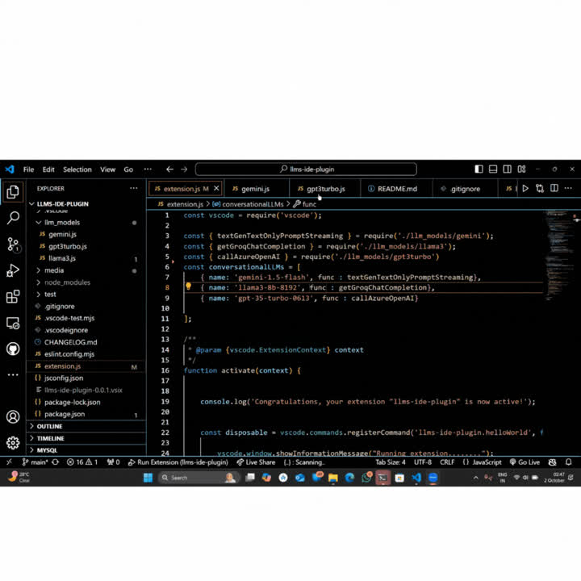


Slide 8

THANK YOU!

